Slide 1
THIS IS WHERE THE TITLE OF THE POWERPOINT GOES
THIS IS WHERE THE SUBTITLE GOES

Slide 2
THIS IS WHERE THE SECTION TITLE GOES.
THIS IS WHERE THE SUBTITLE GOES
(IN ALL CAPS)

Slide 3
THIS IS WHERE THE SUBTITLE GOES
(IN ALL CAPS).
This is where the title of the slide goes.
Itatempo rrovit et et imagnation re et ad ut essim rae pre, consequat vent, inciligent la vitas ipieniet es et latet occaboreptur sequiam.
Ex eatemqu iatur, quam hillaborro eos velenda esecerf erchit fugitium que eicilla borehentum iusanis qui te ipsamet que volorecatur? Simporem nis magni dolest, odicien iminctur?
Maion plia pratem res reriorporem qui cum et qui sunt earum laborporem namet mos cum, es sit quid eumquia sanitat omnimin veligen daerchilita con num ex

Slide 4
This is where the title of the slide goes.
THIS IS WHERE THE SUBTITLE GOES (IN ALL CAPS).
Itatempo rrovit et et imagnation re et ad ut essim rae pre, consequat vent, inciligent la vitas ipieniet es et latet occaboreptur sequiam ex eatemqu iatur, quam hillaborro eos velenda esecerf erchit fugitium que eicilla borehentum iusanis qui te ipsamet que volorecatur? Simporem nis magni dolest, odicien iminctur?
Maion plia pratem res reriorporem qui cum et qui sunt earum laborporem namet mos cum, es sit quid eumquia sanitat omnimin veligen daerchilita con num ex

Slide 5
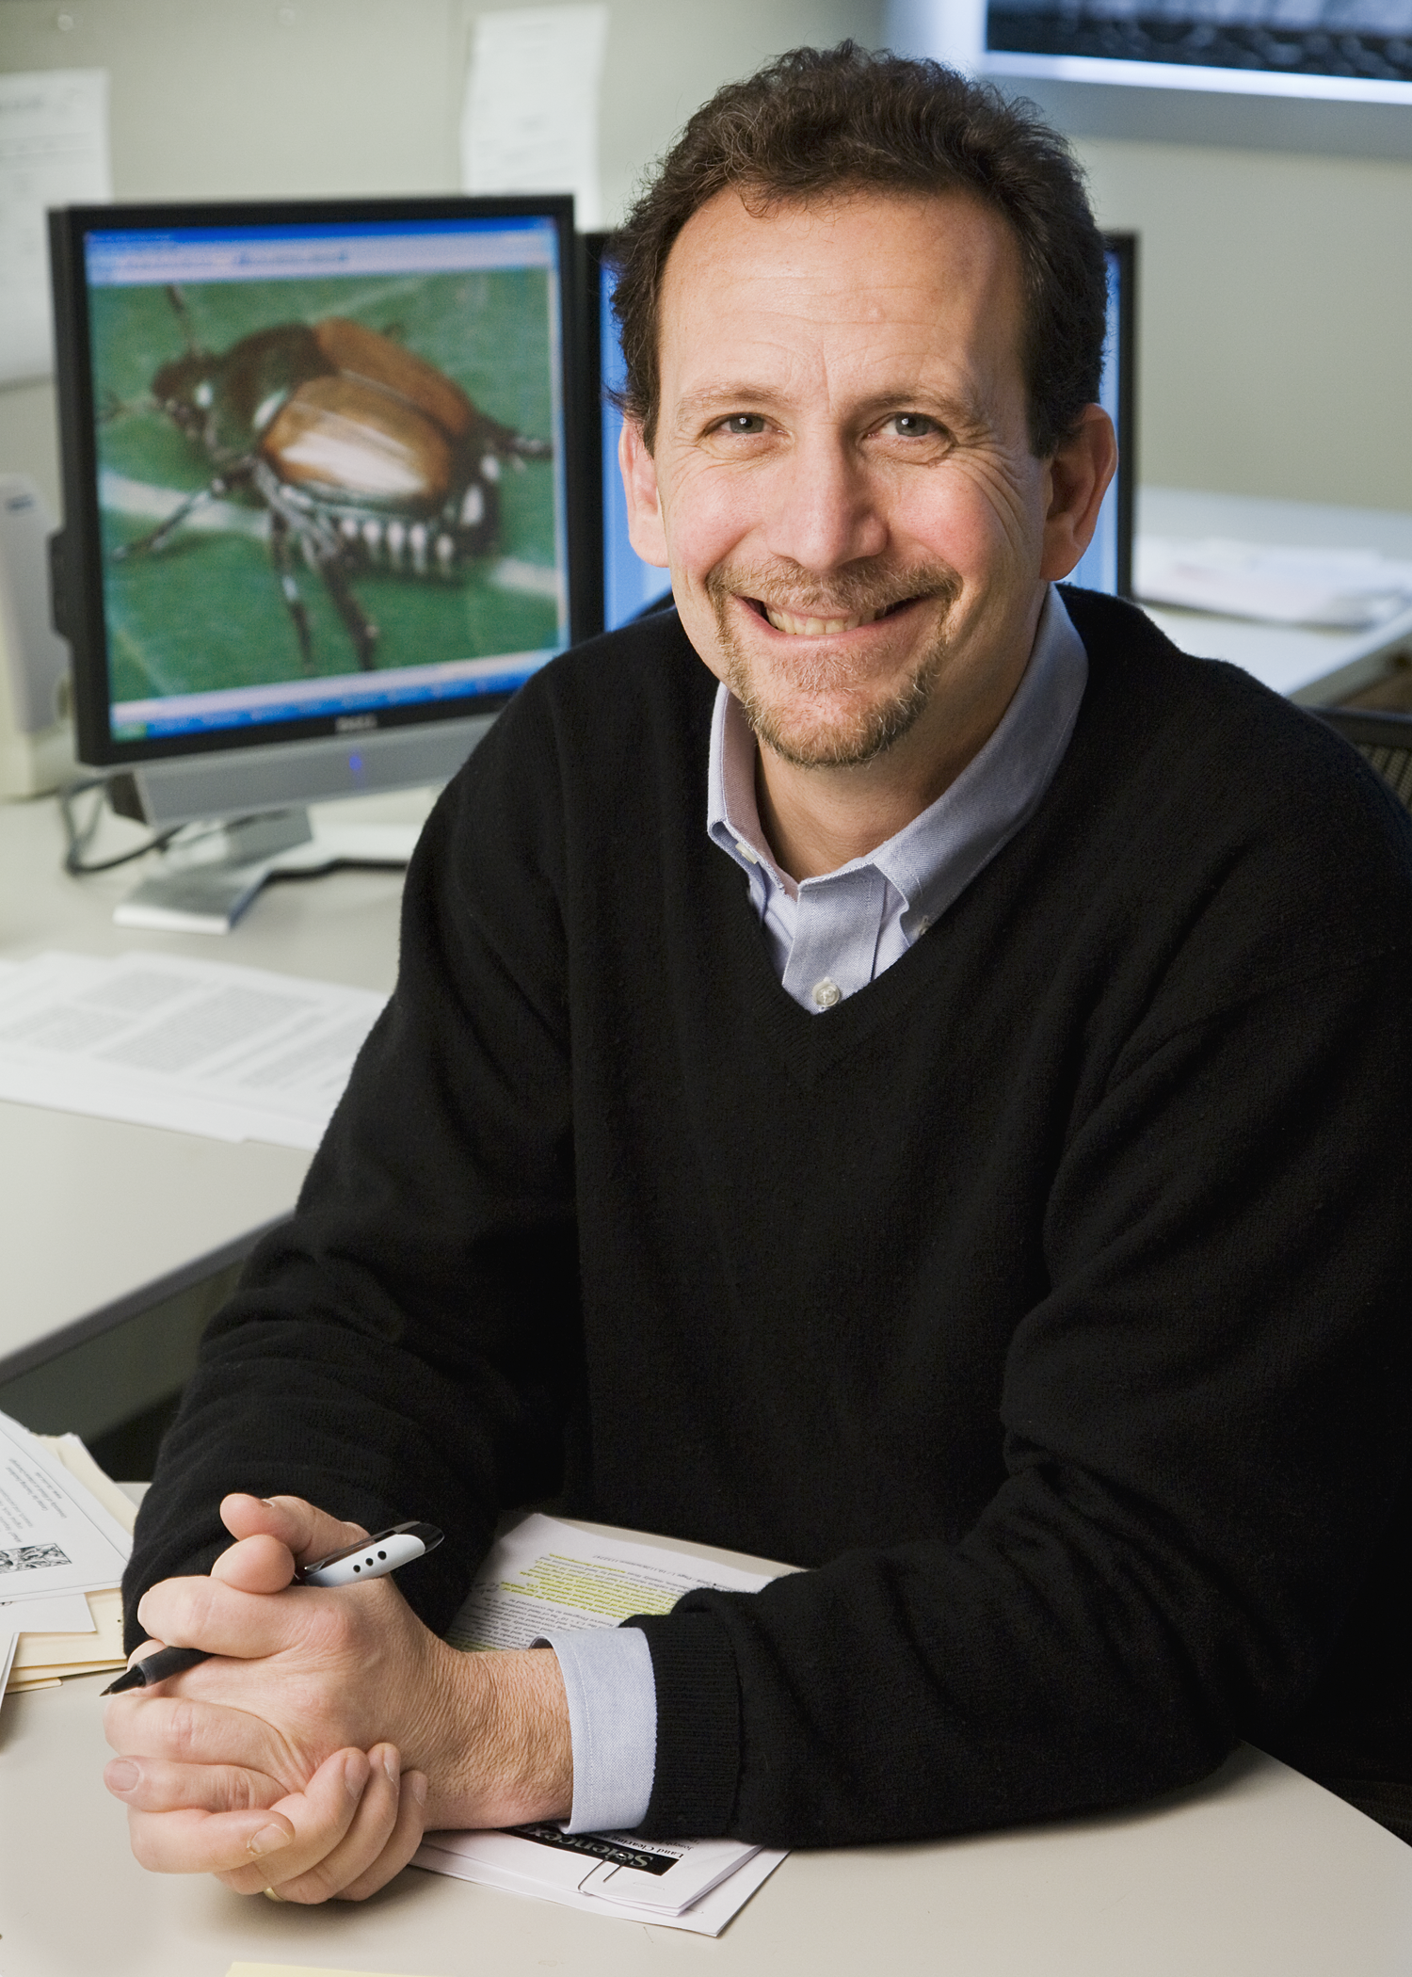
This is where the title of the slide goes.
THIS IS WHERE THE SUBTITLE GOES

Slide 6
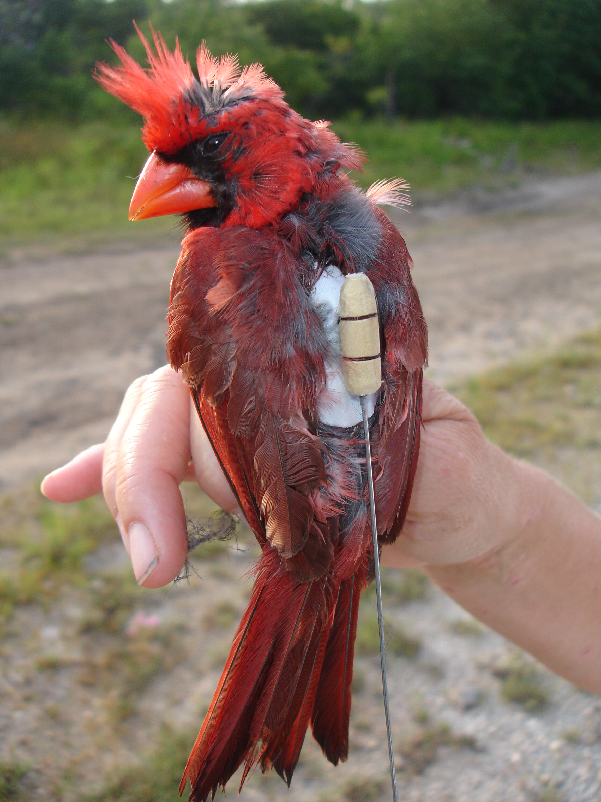
This is where the title of the slide goes.
THIS IS WHERE THE SUBTITLE GOES

Slide 7
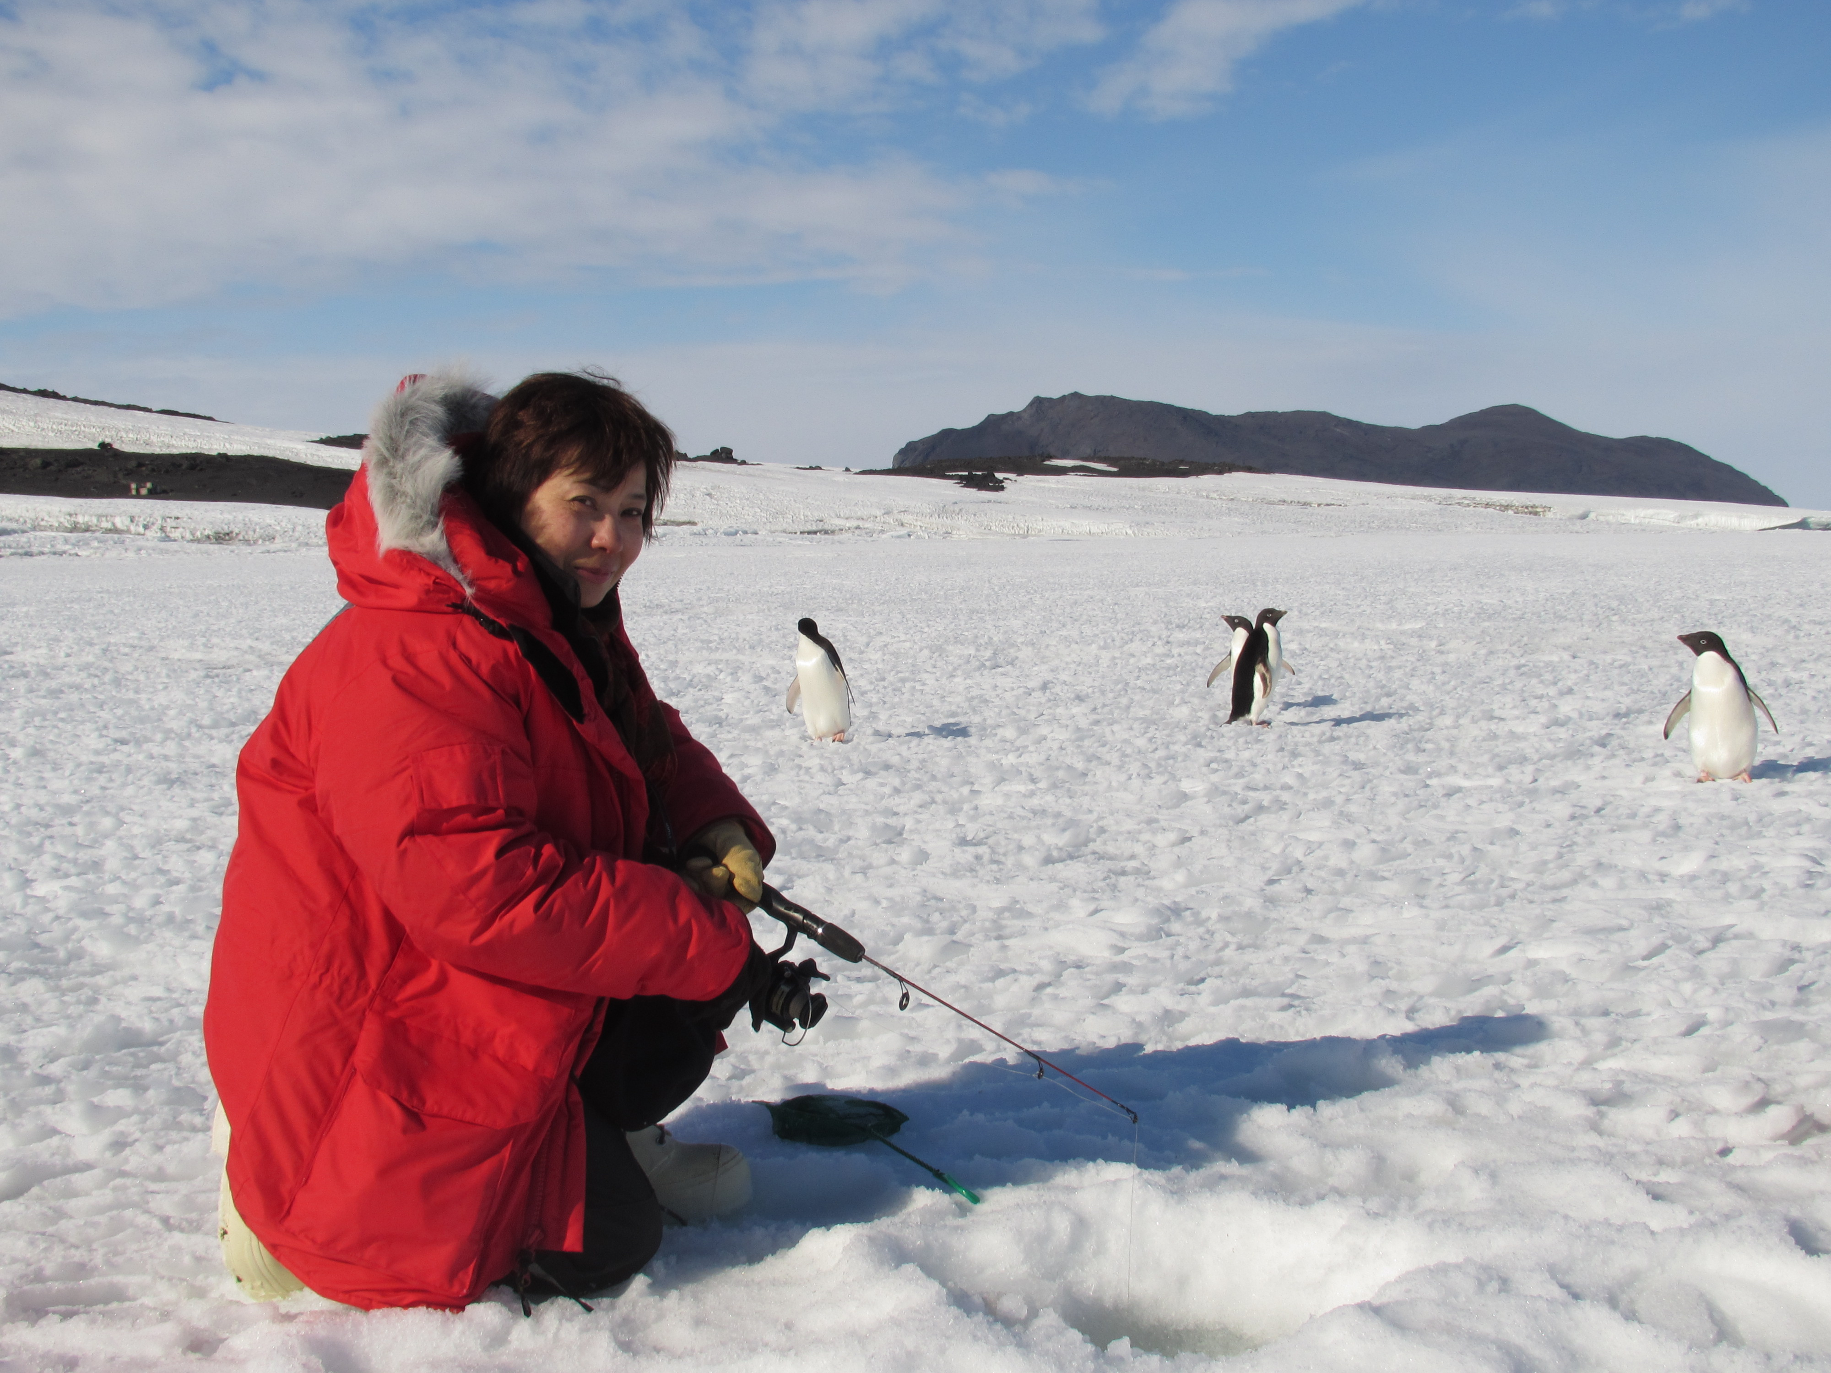
This is where the title of the slide goes.
THIS IS WHERE THE SUBTITLE GOES

Slide 8
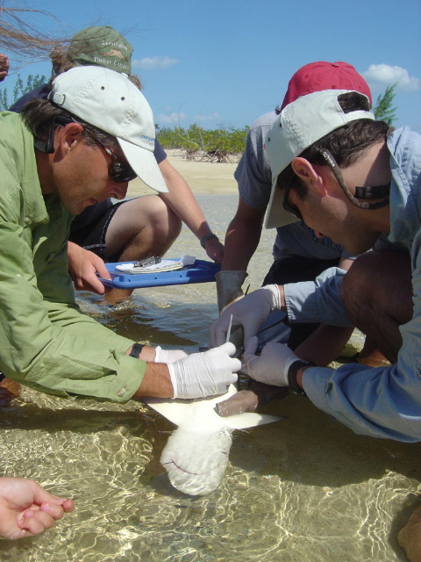
This is where the title of the slide goes.
THIS IS WHERE THE SUBTITLE GOES
Qam hillaborro eos velenda esecerf erchit fugitium que eicilla borehentum iusanis qui te ipsamet que volorecatur? Simporem nis magni dolest, odicien iminctur?

Slide 9
This is where the title of the slide goes.
THIS IS WHERE THE SUBTITLE GOES
THIS IS WHERE THE SUBTITLE GOES
Qam hillaborro eos velenda esecerf erchit fugitium que eicilla borehentum iusanis qui te ipsamet que volorecatur? Simporem nis magni dolest, odicien iminctur?
Eatemqu iatur, quam hillaborro eos velenda esecerf erchit fugitium que eicilla borehentum iusanis qui te ipsamet que volorecatur? Simporem nis magni dolest, odicien iminctur?

